Slide 1
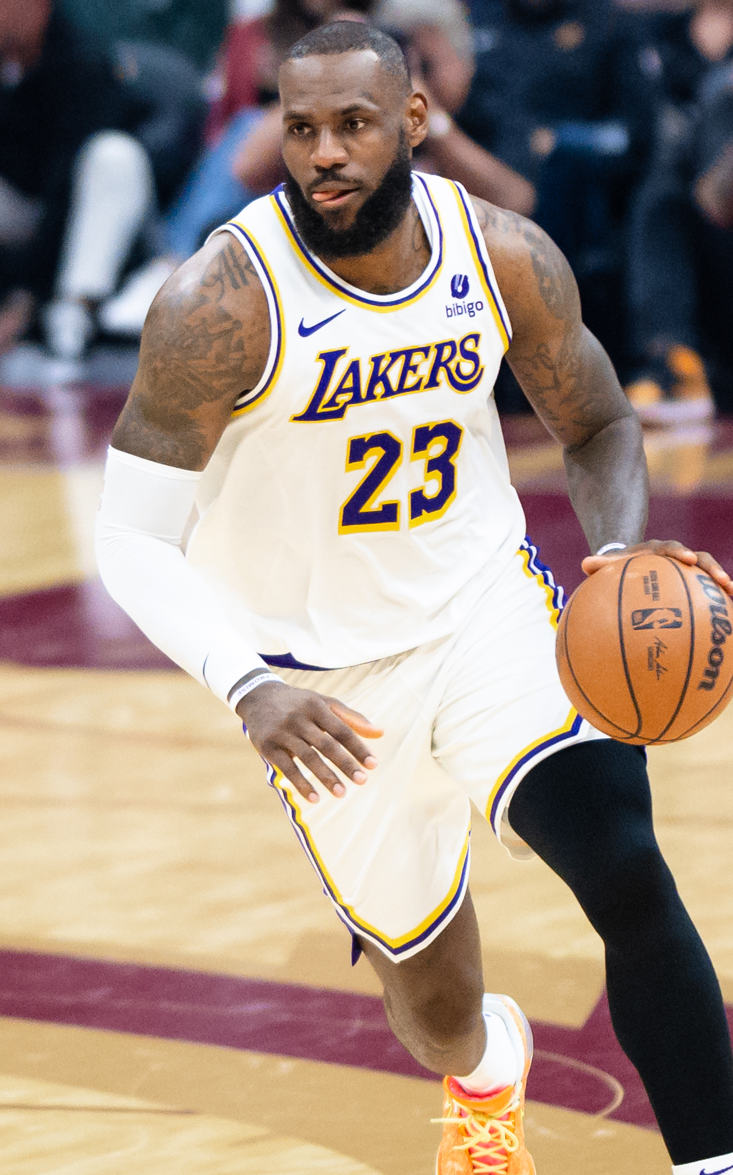
THE
KING
LeBron James
English × Basketball × Exam Skills
國三會考複習｜從國一核心句型重新建立
LESSON 1
BE VERBS
PRESENT SIMPLE
“Who is the King — and why?”
Photo: Erik Drost / Wikimedia Commons (CC BY 2.0)

Slide 2
01 · START
Today's Mission
今天不是背「LeBron 的資料」，而是用他的故事把英文重新接起來。
10
BE
DO
EXAM
core words
am / is / are
play / plays
read + listen
看懂人物故事常見單字
重新確認最基本句子骨架
複習現在簡單式與第三人稱
最後轉回會考閱讀與聽力思維
Suggested flow
10 min
Warm-up
20 min
Vocabulary + Story
20 min
Grammar
20 min
Video / Reading
10 min
Exit Ticket

Slide 3
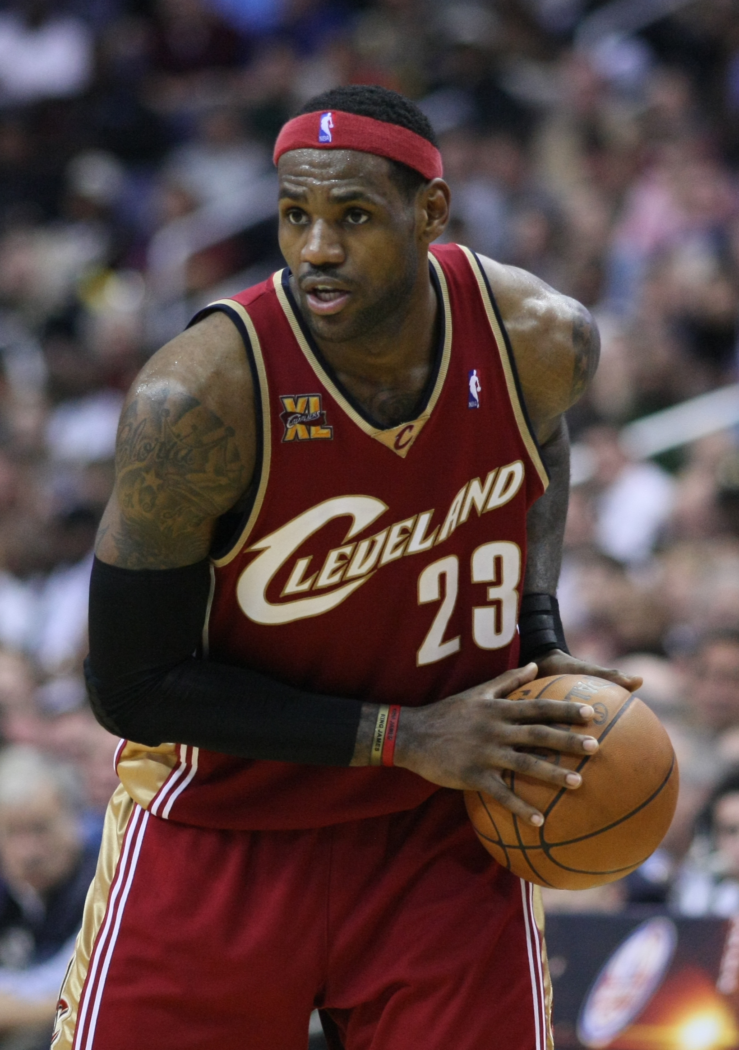
02 · WARM-UP
How Much Do You Know About The King?
1. Where is LeBron from?
A. New York B. Akron C. Miami
2. What number is famous with LeBron?
A. 6 B. 23 C. Both A and B
3. How many NBA championships has he won?
A. 2 B. 4 C. 6
4. Which word fits him best?
leader / scorer / teammate / legend
RULE: Guess first. No Google.
Photo: Keith Allison / Wikimedia Commons (CC BY-SA 2.0)

Slide 4
03 · VOCABULARY
10 Words to Tell a Sports Story
player
球員
a basketball player
teammate
隊友
help a teammate
hometown
家鄉
his hometown
leader
領袖
a team leader
draft
選秀
the NBA Draft
practice
練習
practice every day
championship
冠軍
win a championship
famous
有名的
a famous athlete
score
得分
score 30 points
legend
傳奇
a basketball legend
Quick Challenge → Pick any 3 words and make ONE sentence about LeBron.

Slide 5
04 · STORY
Just a Kid from Akron
LeBron James is from Akron, Ohio. He is one of the most famous basketball players in the world.
As a teenager, he was already a high-school star. In 2003, the Cleveland Cavaliers chose him with the first pick in the NBA Draft.
Today, his story is bigger than basketball. He is also known for helping young people in Akron through education programs.
BLUE = BE VERB (NOW)
GREEN = BE VERB (PAST)
Spot it: How many BE verbs can you find?
Keith Allison / Wikimedia Commons (CC BY-SA 2.0)

Slide 6
05 · GRAMMAR 1
BE Verbs = Identity / Condition
Who is he? Where is he from? What is he like?
I
am
I am a fan.
QUICK CHECK
1. LeBron ___ from Akron.
am / is / are
You / We / They
are
They are teammates.
2. His teammates ___ NBA players.
am / is / are
3. I ___ a basketball fan.
He / She / It
is
He is from Akron.
am / is / are
4. LeBron and Bronny ___ family.
am / is / are
會考提醒｜先找「主詞」再選 be 動詞；不要只看離空格最近的名詞。

Slide 7
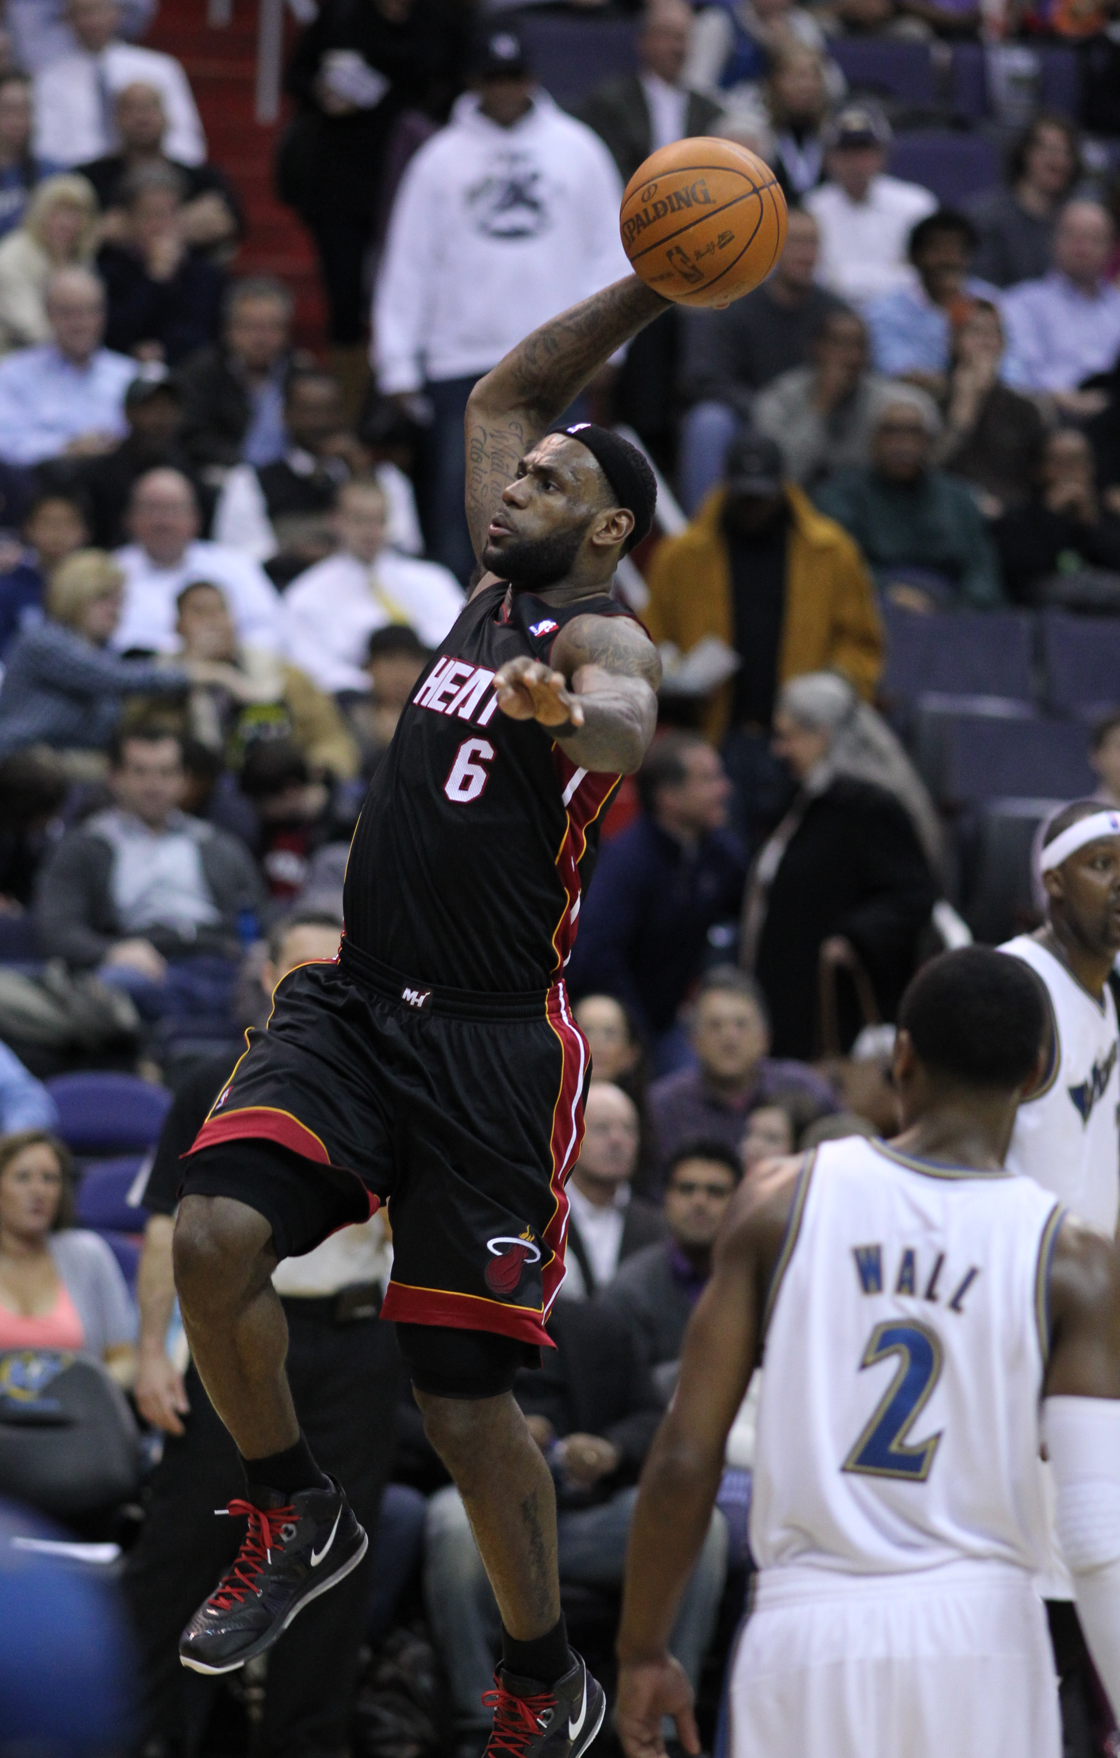
06 · TIMELINE
The Road to “The King”
2003
2012
2013
2016
2020
2023
No. 1 pick
NBA champion
NBA champion
NBA champion
NBA champion
All-time scoring
Cleveland
Miami
Miami
Cleveland
Los Angeles
record
What changed? What stayed the same?
Photos: Keith Allison / Erik Drost • Wikimedia Commons

Slide 8
07 · GRAMMAR 2
Present Simple = Habits / Facts
LeBron plays basketball. He practices. He helps. He has experience.
I / YOU / WE / THEY
DO / DOES
play practice help have
Does LeBron practice a lot?
Yes, he does.
HE / SHE / IT
Does he plays every day?
✗ Does he play every day?
plays practices helps has
He don’t practice.
→ 第三人稱單數：動詞通常加 -s / -es
✗ He doesn’t practice.
陷阱：Does / doesn’t 後面的動詞要回到原形。

Slide 9
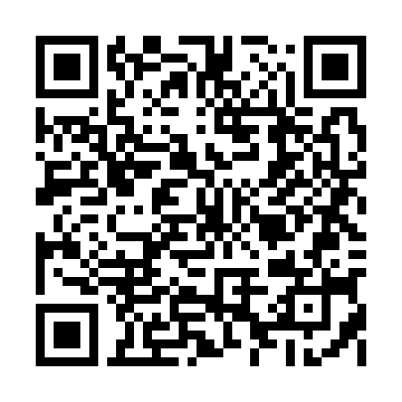
08 · LISTENING
Video Mission: LeBron James Story
1st watch
NO subtitles
Write 3 words or numbers you hear.
▶
2nd watch
Subtitles ON
Find: hometown / year / one achievement.
Search: LeBron James story
3rd watch
Pause & answer
What made his story difficult or special?
Scan / click to choose a 3–5 min video
Teacher tip: 影片不需要全懂。任務要小、可完成，才能把「聽英文」變成可練習的技能。

Slide 10
09 · READING
Exam Reading Challenge
LeBron James grew up in Akron, Ohio, and became a famous basketball player while he was still in high school. In 2003, Cleveland chose him with the first pick in the NBA Draft. During his career, he won championships with three different teams and became the NBA’s all-time leading scorer. However, basketball is only one part of his story. Through his family foundation, he has supported students and education programs in his hometown. For many fans, LeBron is not only a great scorer. He is also a leader who uses his success to help other people.
1. What is the passage mainly about?
A LeBron’s full story and impact
B NBA rules
C Why Akron is famous
D How to join the NBA
2. What happened in 2003?
A He retired.
B Cleveland chose him first.
C He opened a school.
D He won his first title.
3. The word “However” shows…
A time
B contrast
C reason
D example
4. Why does the writer call him a leader?
A He is tall.
B He scores every game.
C He also helps others.
D He was born in Akron.
Read in 90 seconds. Underline: 1 place + 2 years/numbers + 1 “however”.

Slide 11
10 · EXAM SKILL
CEEC Strategy: Don’t Translate Everything
1
2
3
4
看題目
抓關鍵字
回文章定位
刪掉陷阱
先找題目要你找什麼
人名、時間、轉折詞
只讀關鍵句前後
太絕對、沒提到、偷換概念
Example
“However, basketball is only one part of his story.”
however = 前後「相反 / 轉折」 → 下一句通常是考點。
不要逐字翻譯；先找到訊號詞，再判斷作者想轉去哪裡。

Slide 12
11 · SPEAKING
You Are the Reporter
Teacher = LeBron | Student = Reporter → Ask 4 questions. Then switch.
BE
Where are you from?
I am from …
BE
What is your hometown like?
It is …
DO
Do you practice every day?
Yes, I do. / No, I don’t.
DOES
What does a great teammate do?
A great teammate …
WHY
Why do you love basketball?
Because …
CHALLENGE
What makes someone “The King”?
I think … because …
Erik Drost / Wikimedia Commons (CC BY 2.0)

Slide 13
12 · GAME
KING or NOT?
If the sentence is correct → KING. If not → fix it.
1
LeBron is from Akron.
KING / NOT
5
His teammates is NBA players.
KING / NOT
2
He are a famous player.
KING / NOT
6
He doesn’t plays center.
KING / NOT
3
Does LeBron plays basketball?
KING / NOT
7
LeBron and his son are family.
KING / NOT
4
He practices every day.
KING / NOT
8
Why does people call him The King?
KING / NOT
Bonus: Can you explain WHY it is wrong — in Chinese or English?

Slide 14
13 · FINISH
Exit Ticket
1. LeBron ___ from Akron. (am / is / are)
HOMEWORK
“MY KING” — 60 sec
2. He ___ basketball. (play / plays)
Choose ONE person you like:
🏀 athlete 🚲 cyclist
🎬 actor / character 🎵 singer
Use 5 sentences:
• He / She is …
• He / She is from …
• He / She likes …
• He / She does …
• I like him / her because …
3. Does he ___ every day? (practice / practices)
4. Write ONE sentence with “leader”.
5. What is one thing you learned about LeBron?
Next lesson: turn your “My King” into a short reading passage.

Slide 15
APPENDIX
TEACHER ONLY
Teacher Answer Key
Warm-up
BE Quick Check
1 B (Akron)
2 C (6 and 23)
3 B (4 championships)
1 is
2 are
3 am
4 are
Reading
KING or NOT
1 A
2 B
3 B
4 C
1 ✓
2 is
3 play
4 ✓
5 are
6 play
7 ✓
8 do people
Tip: 第一堂先看「能不能說出完整句子」，不要一次糾正所有發音與文法。

Slide 16
APPENDIX
Sources & Image Credits
Content sources
● NBA.com — LeBron James player bio: draft, championships, MVPs, all-time scoring record
● Cleveland Cavaliers — 2003 draft / high-school career background
● LeBron James Family Foundation — Akron and education/community work
● YouTube search reference supplied by teacher: “LeBron James story”
Images
● Keith Allison — LeBron James, Cleveland Cavaliers (2009), CC BY-SA 2.0, Wikimedia Commons
● Keith Allison — LeBronJamesDunkingHeat (2011), CC BY-SA 2.0, Wikimedia Commons
● Erik Drost — LeBron James (2023), CC BY 2.0, Wikimedia Commons
Deck created for classroom use. Verify the exact video selected before class because YouTube search results may change.

